Slide 1
AZ-104T00A Administer Azure Resources

Slide 2
Administer Azure Resources Introduction
Configure Azure Resources with Tools
Configure Resources with ARM Templates
Lab 03b - Manage Azure resources by Using ARM Templates
Lab 03c - Manage Azure resources by Using Azure PowerShell (optional)
Lab 03d - Manage Azure resources by Using Azure CLI (optional)
Notes:
Covered in Module 02 - Lab 03a - Manage Azure resources by Using the Azure Portal. Focus on other tools.

Slide 3
Configure Azure Resources with Tools

Slide 4
Configure Azure Resources with Tools Introduction
Compare Administration tools (4 student topics)
Demonstration – Azure Portal
Demonstration – Azure Cloud Shell
Demonstration – Working with PowerShell locally (optional)
Demonstration – Azure CLI (optional)
Summary and Resources
Notes:
This lesson is not directly related to any certification objectives. However, using the tools will be necessary to complete any hands-on portion of the exam.

Slide 5
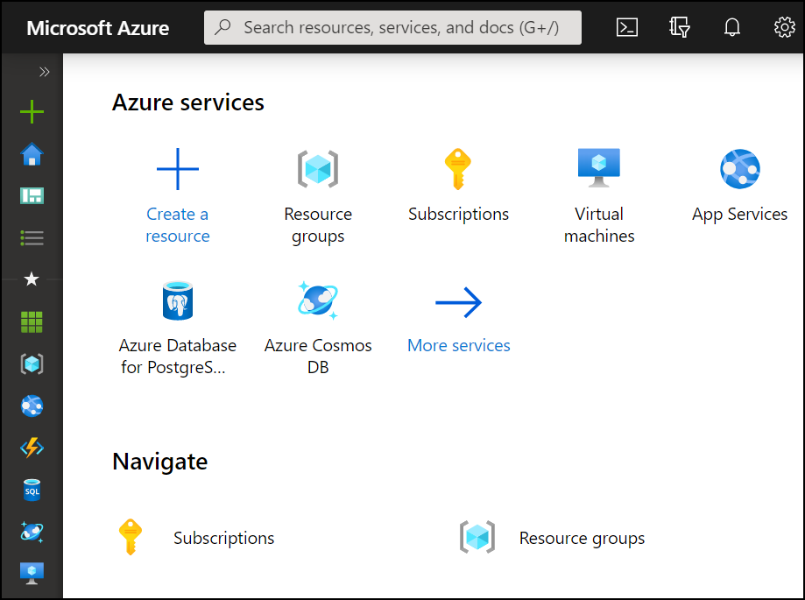
Compare Administrator tools
Azure Portal
View and manage resources Visual interface Unified hub – training and documentation Personalize your experience Mobile app Access the Cloud Shell One-off creation scenarios
Azure Cloud Shell
Interactive and browser-accessible Offers Bash or PowerShell Authenticates automatically Provided on a per-session and per-user basis Temporary - times out after 20 minutes
Azure PowerShell and CLI
Command line programs Interactive and scripting modes Cross-platform Good for repeatable deployments Familiar coding experience
az vm restart -g MyResourceGroup -n MyVm
Notes:
The student content has a page for each tool. This is a summary comparison. The extra slides that were removed are at the end of the presentation.
Azure Portal Overview - https://docs.microsoft.com/azure/azure-portal/azure-portal-overview
Overview of Azure Cloud Shell - https://docs.microsoft.com/azure/cloud-shell/overview
Get started with Azure PowerShell - https://docs.microsoft.com/powershell/azure/get-started-azureps?view=azps-4.3.0
Get started with Azure CLI - https://docs.microsoft.com/cli/azure/get-started-with-azure-cli?view=azure-cli-latest

Slide 6
Demonstration – Azure Portal
Help and keyboard shortcuts
Customizing your experience
Notes:
Students have already seen and worked with the portal. Ask if there are any questions and focus on features they may not have seen, like customization of the dashboard.
✔ Always consider having students walk-through the demonstrations themselves. Also, consider the overlap with the formal labs and your best use of time.

Slide 7
Demonstration – Cloud Shell
Configure the Cloud Shell
Experiment with Azure PowerShell
Experiment with Bash shell
Experiment with the Cloud Editor
Notes:
✔ Always consider having students walk-through the demonstrations themselves. Also, consider the overlap with the formal labs and your best use of time.

Slide 8
Demonstration – Working with the CLI (optional)
Install the CLI
Verify the CLI installation
Login to Azure
Create a resource group
Verify the resource group
Notes:
✔ Always consider having students walk-through the demonstrations themselves. Also, consider the overlap with the formal labs and your best use of time.
Note: If at any time you receive errors about *running scripts is disabled* be sure to set the execution policy:
Set-ExecutionPolicy -ExecutionPolicy RemoteSigned -Scope LocalMachine
Note: You may need to run this code in PowerShell to enable TLSv2:
[Net.ServicePointManager]::SecurityProtocol = [Net.SecurityProtocolType]::Tls12

Slide 9
Summary and Resources – Configure Azure Resources with Tools
Knowledge Check Questions
Microsoft Learn Modules (docs.microsoft.com/Learn)
Manage services with the Azure portal (Sandbox)
Introduction to PowerShell (Sandbox)
Control Azure services with the CLI (Sandbox)
Control and organize Azure resources with Azure Resource Manager
A sandbox indicates a hands-on exercise.
Notes:
Learn - https://docs.microsoft.com/learn/browse/
The Assessment Guide in the MCT DLC has open-ended questions.
Describe the Azure Cloud Shell and the two programming languages it supports.
Answer: The Azure Cloud Shell Interactive, browser-accessible shell. The shell offers coding in either Azure CLI or Azure PowerShell. The shell Is temporary and provided on a per-session, per-user basis. The shell requires a resource group, storage account, and Azure File share. When you use the shell it authenticates automatically and times out after 20 minutes.

Slide 10
Configure Resources with ARM Templates

Slide 11

Configure Resources with ARM Templates Introduction
Review ARM Template Advantages
Explore the JSON Template Schema
Explore the JSON Template Parameters
Consider Azure Bicep Templates
Demonstration – QuickStart Templates
Demonstration – Run Templates with PowerShell (optional)
Summary and Resources
Notes:
Deploy and manage Azure compute resources (20–25%)
Automate deployment of virtual machines (VMs) by using Azure Resource Manager templates
* Modify an Azure Resource Manager template
* Deploy from a template
* Save a deployment as an Azure Resource Manager template

Slide 12
Benefits of using Azure Resource Manager Templates
Declarative language which allows you to automate the deployment of Infrastructure, this is known as IaC.
Used to create repeatable IaC artefacts which allow the deployment of repeatable infrastructure. Use case – deploy multiple identical environments.
ARM templates are based on JSON – and allow you to describe the entire infrastructure, which differ from a scripted deployment.
ARM templates allow you to describe an infrastructure, so that all of the components are created in the correct order (dependencies).
ARM can be enriched using PowerShell, Bash or even Chef and Puppet tools to further advance configurations once the resources are deployed.

Slide 13
Review ARM Template Advantages
Improves consistency and promotes reuse
ARM
Template
Reduce manual, error prone, and repetitive tasks
Express complex deployments
Development
Express requirements through code
Production
Provides validation tasks
Modular and can be linked
Quality
Assurance
Simplifies orchestration
Notes:
What are ARM templates? - https://docs.microsoft.com/azure/azure-resource-manager/templates/overview

Slide 14
Azure Template Components
Parameters – Parameters allow you to pass different values to the ARM template for use during the deployment. Some common examples include names of resources.
Functions – Functions allow you to create complicated expressions that you don’t want to repeat throughout the template. For example, say you need to create unique names for resources. Instead of copying and pasting the same code to generate the unique name, you create a function that makes the unique name.
Variables – Variables are not much different in ARM templates than you find in other programming languages. Variables contain values that are used repeatedly throughout the template.
Resources – The resources section defines what Azure resources to deploy with the template. Resources can be anything as small as a network security group all the way to virtual machines, storage accounts, or Azure Functions.
Outputs – The outputs section defines values and information returned from the deployment.

Slide 15
Explore the JSON Template Schema
Defines all the Resource manager resources in a deployment
{
"$schema": "http://schema.management.
azure.com/schemas/2019-04- 01/deploymentTemplate.json#",
"contentVersion": "",
"parameters": {},
"variables": {},
"functions": [],
"resources": [],
"outputs": {}
}
Written in JSON
A collection of key-value pairs
Each key is a string
Each value can be a string, number, Boolean expression, list of values, object
Notes:
Understand the structure and syntax of ARM templates - https://docs.microsoft.com/azure/azure-resource-manager/templates/template-syntax

Slide 16
Explore the JSON Template Parameters
Specify which values are configurable when the template runs
"parameters": {
"adminUsername": {
"type": "string",
"metadata": {
"description": "Username for the VM."
}
},
"adminPassword": {
"type": "securestring",
"metadata": {
"description": "Password for the VM."
}
}
}
This example has two parameters: one for a VM’s username (adminUsername), and one for its password (adminPassword)
Notes:
Parameters in Azure Resource Manager templates - https://docs.microsoft.com/azure/azure-resource-manager/templates/template-parameters

Slide 17
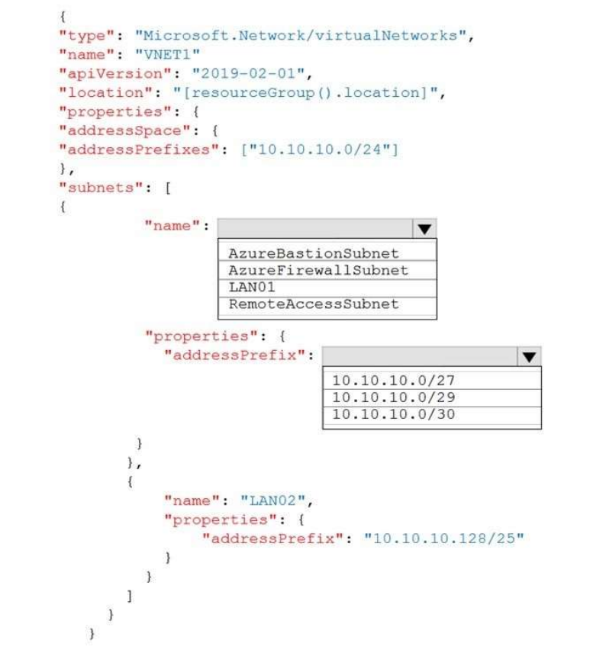

Slide 18
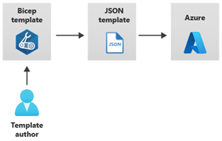
Consider Azure Bicep Templates
Simpler syntax for writing templates
Smaller module files you can reference from a main template
Automatically detect dependencies between your resources
Visual Studio Code extension with validation and IntelliSense
Notes:
What is Bicep? - https://docs.microsoft.com/azure/azure-resource-manager/bicep/overview?tabs=bicep

Slide 19
Demonstration - Quickstart templates
Explore the QuickStart gallery
Explore a template
Notes:
✔ Always consider having students walk-through the demonstrations themselves. Also, consider the overlap with the formal labs and your best use of time.

Slide 20
Demonstration – Run Templates with PowerShell (optional)
Connect to your subscription
Create the resource group
Deploy the template into the resource group
Verify the template deployed
Notes:
✔ Always consider having students walk-through the demonstrations themselves. Also, consider the overlap with the formal labs and your best use of time.

Slide 21
Summary and Resources
Knowledge Check Questions
Microsoft Learn Modules (docs.microsoft.com/Learn)
Create Azure resources using Azure Resource Manager templates
Deploy Azure infrastructure by using JSON ARM templates (Sandbox)
Build your first Bicep template (Sandbox)
A sandbox indicates a hands-on exercise.
Notes:
Learn - https://docs.microsoft.com/learn/browse/ - There are a lot of other Learn modules on templates.
The Assessment Guide in the MCT DLC has open-ended questions.
What are Azure Resource Manager templates and what are the advantages of using them?
Answer: Templates are a programmatic way to define your infrastructure with code. Templates let you create and deploy resources in a consistent manner. Templates improve accuracy and reduce manual errors. Templates can be reused and simplify administration. Templates have a defined schema and uses a declarative syntax.
Name at least three tools an Administrator can use to create and manage Azure resources.
Answer: Azure Portal, Azure CLI, Azure PowerShell, and Azure templates.

Slide 22
Lab 03b - Manage Azure resources by Using ARM Templates Lab 03c - Manage Azure resources by Using Azure PowerShell (optional) Lab 03d - Manage Azure resources by Using Azure CLI (optional)
Notes:
Pick the lab(s) most appropriate for your audience. Lab 03a - Manage Azure resources by Using the Azure Portal was covered in Module 02.

Slide 23
Lab 03b – Manage Azure resources with templates
Lab scenario
Now that you explored the basic Azure administration capabilities associated with provisioning resources and organizing them based on resource groups by using the Azure portal, you need to carry out the equivalent task by using Azure Resource Manager templates
Objectives
Task 1: Review an ARM template for deployment of an Azure managed disk
Task 2: Create an Azure managed disk by using an ARM template
Task 3: Review the ARM template-based deployment of the managed disk
Next slide for an architecture diagram
Notes:
LAB 03b - Manage Azure resources by Using ARM Templates - ESTIMATED DURATION 20 MIN
GitHub Repository - https://microsoftlearning.github.io/AZ-104-MicrosoftAzureAdministrator/

Slide 24



Lab 03b – Architecture diagram
Task 1
Task 2
az104-03a-rg1
JSON
Edit Template
JSON
Deploy
az104-03b-rg1
Template
New Template
az104-03a-disk1
az104-03b-disk1

Slide 25
Lab 03c – Manage Azure resources with PowerShell (optional)
Lab scenario
Now that you explored the basic Azure administration capabilities associated with provisioning resources and organizing them based on resource groups by using the Azure portal and Azure Resource Manager templates, you want the equivalent tasks with Azure PowerShell. To avoid installing Azure PowerShell modules, you will leverage the Azure Cloud Shell
Objectives
Task 1: Start a PowerShell session in Azure Cloud Shell
Task 2: Create a resource group and an Azure managed disk with Azure PowerShell
Task 3: Configure the managed disk by using Azure PowerShell
Next slide for an architecture diagram
Notes:
LAB 03c - Manage Azure resources by Using Azure PowerShell - ESTIMATED DURATION 20 MIN
GitHub Repository - https://microsoftlearning.github.io/AZ-104-MicrosoftAzureAdministrator/

Slide 26
Lab 03c – Architecture diagram
Task 1, Task 2, Task 3
az104-03c-rg1
az104-03c-disk1

Slide 27
Lab 03d – Manage Azure resources with the Azure CLI (optional)
Lab scenario
Now that you explored the basic Azure administration capabilities associated with provisioning resources and organizing them based on resource groups by using the Azure portal, Azure Resource Manager templates, and Azure PowerShell, you need to carry out the equivalent task by using Azure CLI. To avoid installing Azure CLI, you will leverage Bash environment available in Azure Cloud Shell
Objectives
Task 1: Start a Bash session in Azure Cloud Shell
Task 2: Create a resource group and a managed disk by using Azure CLI
Task 3: Configure the managed disk by using Azure CLI
Next slide for an architecture diagram
Notes:
LAB 03d - Manage Azure resources by Using Azure CLI - ESTIMATED DURATION 20 MIN
GitHub Repository - https://microsoftlearning.github.io/AZ-104-MicrosoftAzureAdministrator/

Slide 28
Lab 03d – Architecture diagram
Task 1, Task 2, Task 3
az104-03d-rg1
az104-03d-disk1

Slide 29

End of presentation

Slide 30
Review PowerShell Cmdlets and Modules
Get-Module
# Output
ModuleType Version Name
---------- ------- ----
Manifest 3.1.0.0 Microsoft.PowerShell.Management
Manifest 3.1.0.0 Microsoft.PowerShell.Utility
Binary 1.0.0.1 PackageManagement
Script 1.0.0.1 PowerShellGet
Script 2.0.0 PSReadline
Cmdlets follow a verb-noun naming convention; shipped in modules
Modules are a DLL file with the code to process each cmdlet
Load cmdlets by loading the module containing them
Use Get-Module to see a list of loaded modules
Notes:
Student Content
A PowerShell command is called a *cmdlet* (pronounced "command-let"). A *cmdlet* is a command that manipulates a single feature. The term cmdlet is intended to imply that it is a small command. By convention, cmdlet authors are encouraged to keep cmdlets simple and single purpose.
The base PowerShell product ships with cmdlets that work with features such as sessions and background jobs. You add modules to your PowerShell installation to get cmdlets that manipulate other features. For example, there are third-party modules to work with ftp, administer your operating system, and access the file system.
Cmdlets follow a verb-noun naming convention; for example, **Get-Process**, **Format-Table**, and **Start-Service**.
Verbs also have a convention. You can use **Get-Verb** to retrieve examples, such as:
- **get** retrieves data.
- **set** inserts or updates data.
- **format** formats data.
- **out** directs output to a destination.
Cmdlet authors are encouraged to include a help file for each cmdlet. The **Get-Help** cmdlet displays the help file for any cmdlet. For example, you could get help on the `Get-ChildItem` cmdlet with the following statement:
```powershell
Get-Help Get-ChildItem -detailed
```
Cmdlets are shipped in _modules. A *PowerShell module* is a DLL file that includes the code to process each available cmdlet. You load cmdlets into PowerShell by loading the module containing them. You can get a list of loaded modules using the `Get-Module` command:
```powershell
Get-Module
```
The 'Get-Module' command will output something like the following code:
```output
ModuleType Version Name ExportedCommands
---------- ------- ---- ----------------
Manifest 3.1.0.0 Microsoft.PowerShell.Management {Add-Computer, Add-Content, Checkpoint-Computer, Clear-Con...
Manifest 3.1.0.0 Microsoft.PowerShell.Utility {Add-Member, Add-Type, Clear-Variable, Compare-Object...}
Binary 1.0.0.1 PackageManagement {Find-Package, Find-PackageProvider, Get-Package, Get-Pack...
Script 1.0.0.1 PowerShellGet {Find-Command, Find-DscResource, Find-Module, Find-RoleCap...
Script 2.0.0 PSReadline {Get-PSReadLineKeyHandler, Get-PSReadLineOption, Remove-PS...
```

Slide 31
Use the Azure Portal
Search resources, services, and docs
Manage resources
Create customized dashboards and favorites
Access the Cloud Shell
Receive notifications
Notes:
Azure Portal Overview - https://docs.microsoft.com/azure/azure-portal/azure-portal-overview

Slide 32
Use Azure Cloud Shell
Interactive, browser-accessible shell
Offers either Bash or PowerShell
Is temporary and provided on a per-session, per-user basis
Requires a resource group, storage account, and Azure File share
Authenticates automatically
Integrated graphical text editor
Is assigned one machine per user account
Times out after 20 minutes
Notes:
Overview of Azure Cloud Shell - https://docs.microsoft.com/azure/cloud-shell/overview

Slide 33
Use Azure PowerShell
New-AzVm `
-ResourceGroupName "CrmTestingResourceGroup" `
-Name "CrmUnitTests" `
-Image "UbuntuLTS" `
...
Connect to your Azure subscription and manage resources
Adds the Azure-specific commands
Available inside a browser via the Azure Cloud Shell
Available as a local installation on Linux, macOS, or Windows
Has an interactive and a scripting mode
Notes:
Get started with Azure PowerShell - https://docs.microsoft.com/powershell/azure/get-started-azureps?view=azps-4.3.0
Ask about the classes experience with PowerShell and Azure PowerShell.

Slide 34
Use Azure CLI
az vm restart -g MyResourceGroup -n MyVm
Cross-platform command-line program
Runs on Linux, macOS, and Windows
Can be used interactively or through scripts
Commands are structured in _groups_ and _subgroups_
Use find to locate commands
Use --help for more detailed information
Notes:
Get started with Azure CLI - https://docs.microsoft.com/cli/azure/get-started-with-azure-cli?view=azure-cli-latest
Ask about the students experience with CLI.

Slide 35
Review QuickStart Templates
Resource Manager templates provided by the Azure community
Provides everything you need to deploy your solution or serves as a starting point for your template
https://azure.microsoft.com/resources/templates/
Notes:
QuickStart Templates - https://azure.microsoft.com/resources/templates/

Slide 36
Lesson 02: Use Azure Resource Manager

Slide 37
Use Azure Resource Manager Introduction
Review Resource Manager Benefits
Review Azure Resource Terminology
Create Resource Groups
Create Resource Manager Locks
Reorganize Azure Resources
Remove Resources and Resource Groups
Determine Resource Limits
Demonstration – Resource Groups
Summary and Resources
Notes:
Manage Azure identities and governance (15-20%)
Manage subscriptions and governance
Configure resource locks
Create and manage resource groups (move and remove)

Slide 38
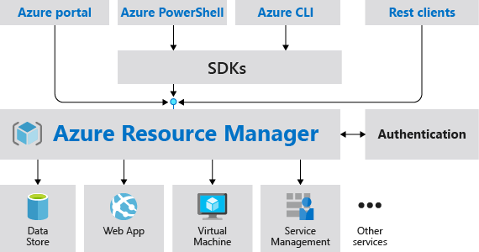
Review Resource Manager Benefits
Provides a consistent management layer
Enables you to work with the resources in your solution as a group
Deploy, update, or delete in a single, coordinated operation
Provides security, auditing, and tagging features
Choose the tools and APIs that work best for you
Notes:
What is Azure Resource Manager? - https://docs.microsoft.com/azure/azure-resource-manager/management/overview

Slide 39
Review Azure Resource Terminology
A resource is simply a single service instance in Azure
A resource group is a logical grouping of resources
An Azure Resource Manager template is a JSON file that allows you to declaratively describe a set of resources
A declarative syntax is what a template uses to state what you intend to create
A resource provider is service that supplies the resources you can deploy and manage through Resource Manager

Slide 40
Create Resource Groups
Resources can only exist in one resource group
Resources grouped (Web + DB, VM, Storage) in one group
Groups can have resources of many different types (services) and from many different regions
OR
Groups cannot be renamed
Web and DB resource group
Virtual machine resource group
Storage resource group
Groups cannot be nested
Deployments are incremental
Notes:
Manage Azure Resource Manager resource groups by using the Azure portal - https://docs.microsoft.com/azure/azure-resource-manager/management/manage-resource-groups-portal

Slide 41
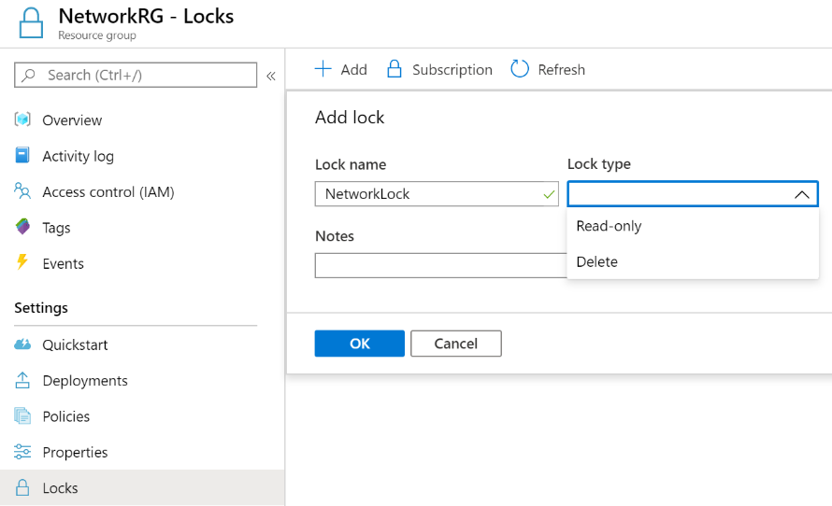
Create Resource Manager Locks
Associate the lock with a subscription, resource group, or resource
Locks are inherited by child resources
Read-Only locks prevent any changes to the resource
Delete locks prevent deletion
Notes:
Lock resources to prevent unexpected changes: https://docs.microsoft.com/azure/azure-resource-manager/resource-group-lock-resources
Control and organize Azure resources with Azure Resource Manager - https://docs.microsoft.com/learn/modules/control-and-organize-with-azure-resource-manager/
✔ Only Owner and User Access Administrator roles can create or delete management locks.

Slide 42
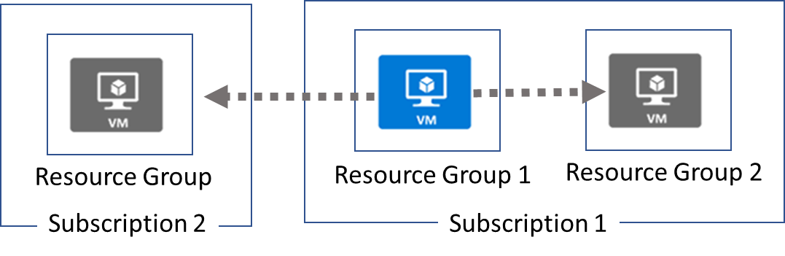
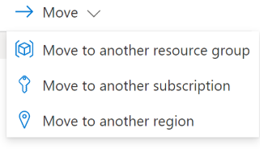
Reorganize Azure Resources
When moving resources, both the source group and the target group are locked during the operation
Services that cannot be moved: Azure AD Domain Services, ExpressRoute, and Site Recovery. Other restrictions apply
Notes:
Move resources to new resource group or subscription - https://docs.microsoft.com/azure/azure-resource-manager/resource-group-move-resources
✔ Just because a service can be moved doesn’t mean there aren’t restrictions. For example, you can move a virtual network, but you must also move its dependent resources, like gateways. Learn more at the reference link.

Slide 43
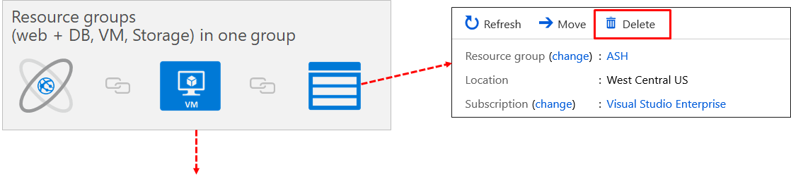
Remove Resources and Resource Groups
Remove Azure resources that you no longer use
Ensures you will not see unexpected charges
Remove individual resources or remove the resource group
Notes:
Manage Azure Resource Manager resource groups by using the Azure portal - https://docs.microsoft.com/azure/azure-resource-manager/management/manage-resource-groups-portal
Move Azure resources to another resource group - https://docs.microsoft.com/learn/modules/move-azure-resources-another-resource-group/

Slide 44
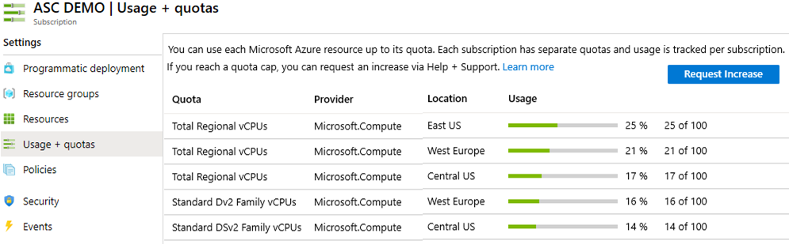
Determine Resource Limits
Resources have a default limit also known as quota
Helpful to track current usage, and plan for future use
You can open a free support case to increase limits to published maximums
Notes:
Azure subscription and service limits, quotas, and constraints - https://docs.microsoft.com/azure/azure-resource-manager/management/azure-subscription-service-limits

Slide 45
Demonstration – Resource Groups
Manage resource groups in the portal
Manage resource groups with PowerShell
Notes:
✔ Always consider having students walk-through the demonstrations themselves. Also, consider the overlap with the formal labs and your best use of time.

Slide 46
Summary and Resources – Use Azure Resource Manager
Knowledge Check Questions
Microsoft Learn Modules (docs.microsoft.com/Learn)
Control and organize Azure resources with Azure Resource Manager
Notes:
Learn - https://docs.microsoft.com/learn/browse/

